Slide 1
Legal Duties of Board Service
Duty of Care
Duty of Loyalty
Duty of Obedience
FOLLOW THE CONVERSATION: WWW.IASA.ORG
@IASAINC
@IASA
@IASAINC
Notes:
The board of directors of a nonprofit corporation has the ultimate responsibility and accountability for the conduct and performance of the organization. Boards regularly delegate the work of the organization to staff and volunteers, but you cannot delegate or reassign your responsibility for that work. You have three fundamental legal duties.

Slide 2
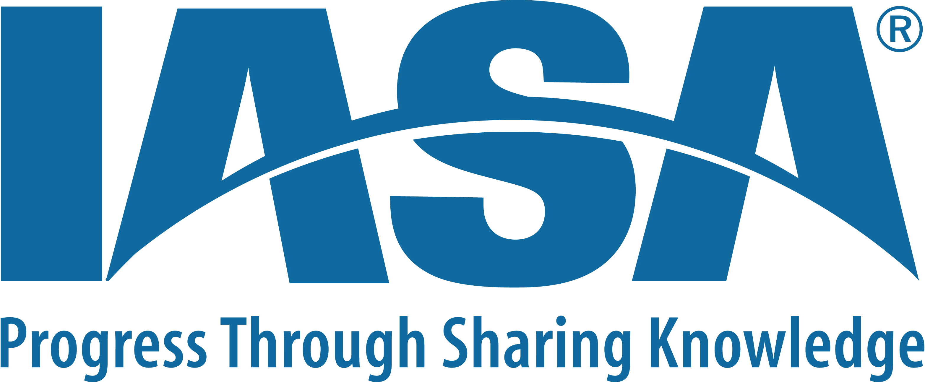
Board Duty
Ways You Can Fulfill This Duty
Use your best judgement.
Stay informed about the performance and health of chapter.
Prepare for and attend board/committee meetings
Ask questions.
Participate in discussions, deliberations, and decisions.
Make decisions based on sound information rather than opinions.
Do not disclose confidential information about the association or chapter.
The Duty of Care:
The board and the board member’s obligation to be reasonably informed, to act in good faith, and to be diligent in making decisions

Slide 3
Board Duty
Ways You Can Fulfill This Duty
Act on behalf of the good of your organization, not your personal or professional interests nor the interests of a special constituency.
Comply with your association’s written conflict-of-interest policy regarding disclosure, avoidance, recusal and management of conflicts of interest.
Make the interests of the association your primary focus and commitment in your board work.
The Duty of Loyalty:
The board and the board member’s obligation to be accountable by putting your personal interests aside for the greater good of the association.

Slide 4
Board Duty
Ways You Can Fulfill This Duty
Make decisions that conform to your association’s mission/
Comply with applicable federal, state, and local laws (e.g., filing tax forms, paying employment taxes, and publicly disclosing selective information).
Adhere to your organizations and chapters bylaws and other governing documents.
The Duty of Obedience:
The board and the board member’s obligation to comply with legal, regulatory, and reporting requirements and to serve as a guardian of your association’s mission

