Slide 1


Central Illinois
CHAPTER
WELCOME!

Slide 2

Presentation Title
SPEAKER NAME
Date
# CPE Credits
Sponsored By:

Slide 3
SPEAKER NAME
Speaker Bio
Speaker Bio Text

Slide 4

PRESENTATION SLIDE
ENTER TEXT HERE
place text here
ENTER TEXT HERE
place text here
ENTER TEXT HERE
place text here

Slide 5
PRESENTATION SLIDE

Slide 6

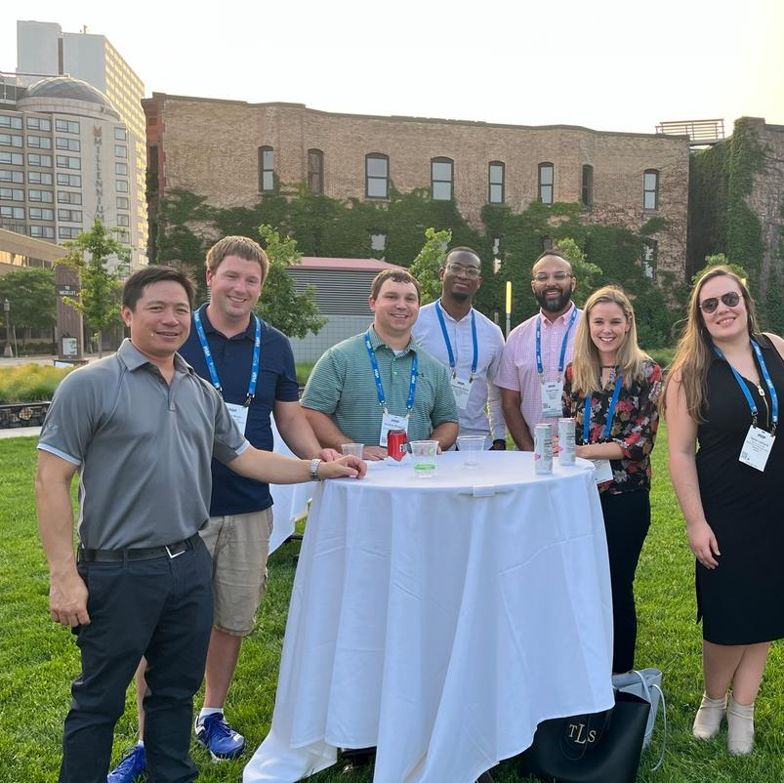

For almost 100 years, IASA has served as the trusted source for knowledge and innovation that guides the community of insurance professionals.

Slide 7
JOIN, CONTRIBUTE & GROW!
As a member of IASA, you are connected to a global network of over 20,000 insurance professionals. IASA puts education and professional resources at your fingertips to help you stay up to date on trends impacting the insurance industry.
Member Benefits
  Discounts to Chapter Meetings, Xchange & OnPoint Conferences
  Engagement & Networking with IASA Chapters – thousands of members
  Access to High Quality eLearning Webinars
  Access to our industry-specific Career Center
  Volunteer Opportunities for Leadership, Networking, and Member Engagement
  Online Membership Directory
  Discounts on Webinars and Events
To join or renew, please contact IASA’s Membership Team today at membership@iasa.org

Slide 8
WHAT’S AHEAD
OUR NEXT CHAPTER EVENT
DATE
Location
IASA XCHANGE & ONPOINT
June 2–5, 2024
Pittsburgh, PA
FULL LIST OF EVENTS
www.iasa.org

Slide 9









FOLLOW US!
@IASAinc

